Slide 1
Pins and signals

Slide 2
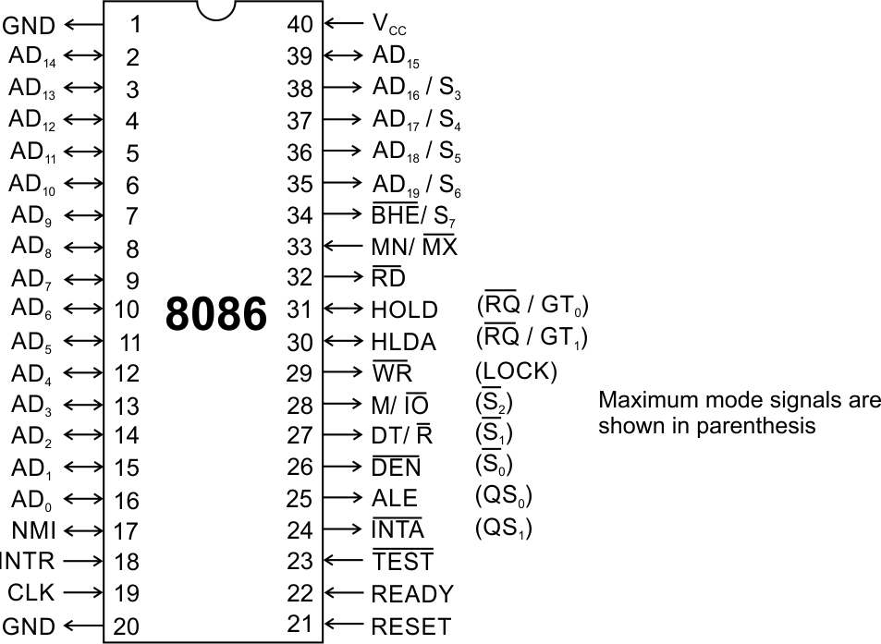
Pins and Signals
8086 Microprocessor
Common signals
AD₀-AD₁₅ (Bidirectional)
Address/Data bus
Low order address bus; these are multiplexed with data.
When AD lines are used to transmit memory address the symbol A is used instead of AD, for example A₀-A₁₅.
When data are transmitted over AD lines the symbol D is used in place of AD, for example D₀-D₇, D₈-D₁₅ or D₀-D₁₅.
A₁₆/S₃, A₁₇/S₄, A₁₈/S₅, A₁₉/S₆
High order address bus. These are multiplexed with status signals

Slide 3
Pins and Signals
8086 Microprocessor
Common signals
BHE (Active Low)/S₇ (Output)
Bus High Enable/Status
It is used to enable data onto the most significant half of data bus, D₈-D₁₅. 8-bit device connected to upper half of the data bus use BHE (Active Low) signal. It is multiplexed with status signal S₇.
MN/ MX
MINIMUM / MAXIMUM
This pin signal indicates what mode the processor is to operate in.
RD (Read) (Active Low)
The signal is used for read operation.
It is an output signal.
It is active when low.

Slide 4
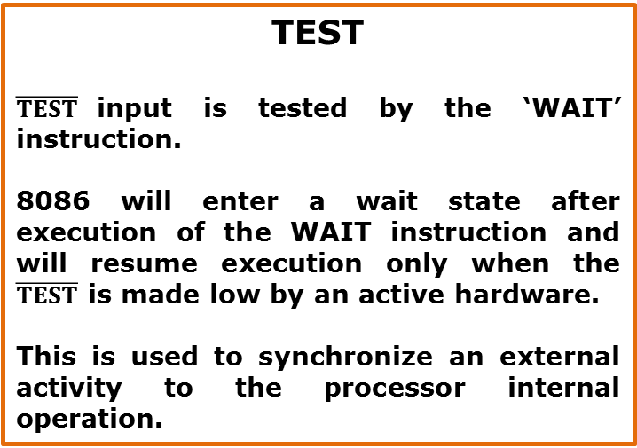
Pins and Signals
8086 Microprocessor
Common signals
TEST
$\overline{TEST}$input is tested by the ‘WAIT’ instruction.
8086 will enter a wait state after execution of the WAIT instruction and will resume execution only when the $\overline{TEST}$ is made low by an active hardware.
This is used to synchronize an external activity to the processor internal operation.
READY
This is the acknowledgement from the slow device or memory that they have completed the data transfer.
The signal made available by the devices is synchronized by the 8284A clock generator to provide ready input to the 8086.
The signal is active high.

Slide 5
Pins and Signals
8086 Microprocessor
Common signals
RESET (Input)
Causes the processor to immediately terminate its present activity.
The signal must be active HIGH for at least four clock cycles.
CLK
The clock input provides the basic timing for processor operation and bus control activity. Its an asymmetric square wave with 33% duty cycle.
INTR Interrupt Request
This is a triggered input. This is sampled during the last clock cycles of each instruction to determine the availability of the request. If any interrupt request is pending, the processor enters the interrupt acknowledge cycle.
This signal is active high and internally synchronized.

Slide 6
Pins and Signals
8086 Microprocessor
Min/ Max Pins
The 8086 microprocessor can work in two modes of operations : Minimum mode and Maximum mode.
In the minimum mode of operation the microprocessor do not associate with any co-processors and can not be used for multiprocessor systems.
In the maximum mode the 8086 can work in multi-processor or co-processor configuration.
Minimum or maximum mode operations are decided by the pin MN/ MX(Active low).
When this pin is high 8086 operates in minimum mode otherwise it operates in Maximum mode.

Slide 7


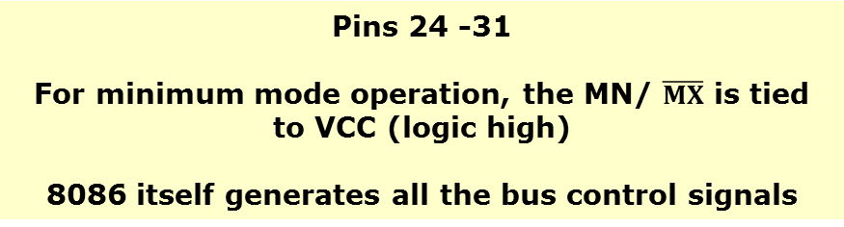

Pins and Signals
8086 Microprocessor
Minimum mode signals
Pins 24 -31
For minimum mode operation, the MN/ $\overline{MX}$ is tied to VCC (logic high)
8086 itself generates all the bus control signals
DT/$\overline{R}$ | (Data Transmit/ Receive) Output signal from the processor to control the direction of data flow through the data transceivers
$$\overline{DEN}$$ | (Data Enable) Output signal from the processor used as out put enable for the transceivers
ALE | (Address Latch Enable) Used to demultiplex the address and data lines using external latches
M/$\overline{IO}$ | Used to differentiate memory access and I/O access. For memory reference instructions, it is high. For IN and OUT instructions, it is low.
$$\overline{WR}$$ | Write control signal; asserted low Whenever processor writes data to memory or I/O port
$$\overline{INTA}$$ | (Interrupt Acknowledge) When the interrupt request is accepted by the processor, the output is low on this line.

Slide 8
Pins and Signals
8086 Microprocessor
Minimum mode signals
Pins 24 -31
For minimum mode operation, the MN/ $\overline{MX}$ is tied to VCC (logic high)
8086 itself generates all the bus control signals
HOLD | Input signal to the processor form the bus masters as a request to grant the control of the bus. Usually used by the DMA controller to get the control of the bus.
HLDA | (Hold Acknowledge) Acknowledge signal by the processor to the bus master requesting the control of the bus through HOLD. The acknowledge is asserted high, when the processor accepts HOLD.

Slide 9
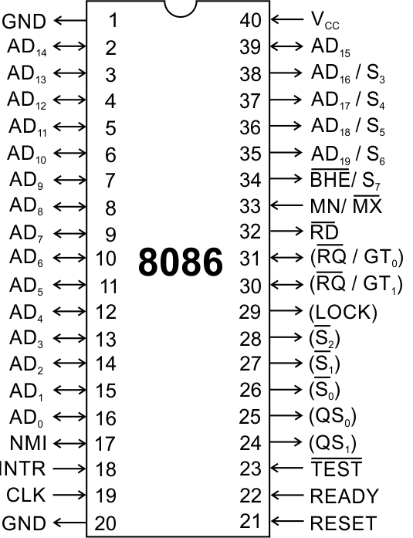
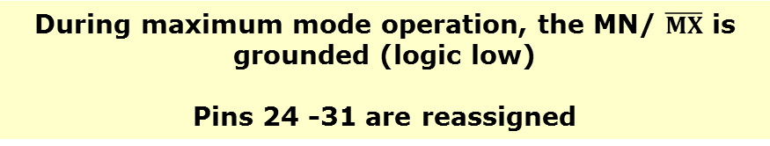
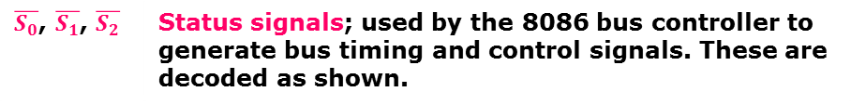
Pins and Signals
8086 Microprocessor
Maximum mode signals
During maximum mode operation, the MN/ $\overline{MX}$ is grounded (logic low)
Pins 24 -31 are reassigned
$\overline{S_{0}}$, $\overline{S_{1}}$, $\overline{S_{2}}$ | Status signals; used by the 8086 bus controller to generate bus timing and control signals. These are decoded as shown.

Slide 10
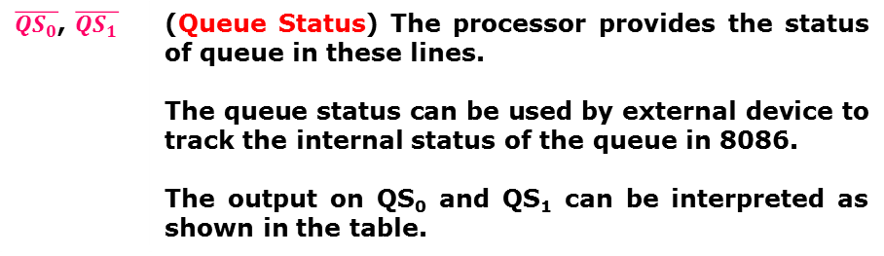
Pins and Signals
8086 Microprocessor
Maximum mode signals
During maximum mode operation, the MN/ $\overline{MX}$ is grounded (logic low)
Pins 24 -31 are reassigned
$\overline{{QS}_{0}}$, $\overline{QS_{1}}$ | (Queue Status) The processor provides the status of queue in these lines. The queue status can be used by external device to track the internal status of the queue in 8086. The output on QS₀ and QS₁ can be interpreted as shown in the table.

Slide 11
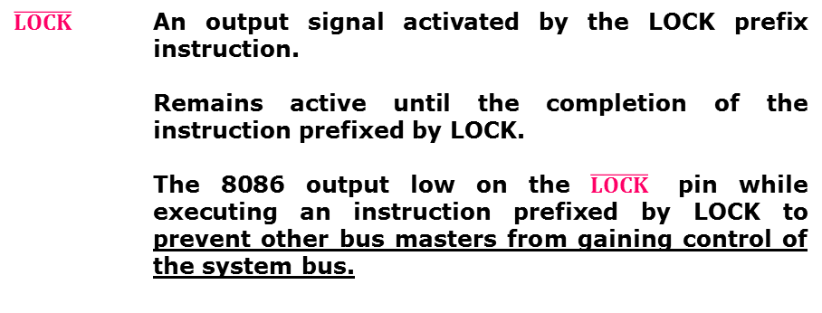
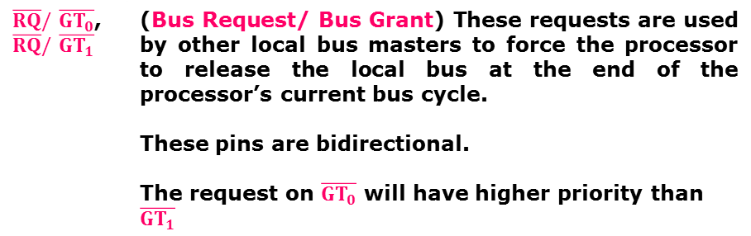
Pins and Signals
8086 Microprocessor
Maximum mode signals
During maximum mode operation, the MN/ $\overline{MX}$ is grounded (logic low)
Pins 24 -31 are reassigned
$\overline{RQ}/\overline{GT_{0}}$, $\overline{RQ}/\overline{GT_{1}}$ | (Bus Request/ Bus Grant) These requests are used by other local bus masters to force the processor to release the local bus at the end of the processor’s current bus cycle. These pins are bidirectional. The request on$\overline{GT_{0}}$ will have higher priority than$\overline{GT_{1}}$
$$\overline{LOCK}$$ | An output signal activated by the LOCK prefix instruction. Remains active until the completion of the instruction prefixed by LOCK. The 8086 output low on the $\overline{LOCK}$ pin while executing an instruction prefixed by LOCK to prevent other bus masters from gaining control of the system bus.

